Slide 1
Unit 2.1 -
JavaScript Fundamentals
CS 101

Slide 2
Bell Work
Please Update your Zoom Account
Add a profile picture to your account - this needs to be of your face, use the pictures from the slides if you want to
Change your name to be your full first and last name (nicknames should be in parenthesis)

Slide 3
Variables
Where we put the values

Slide 4
Variables
There are several types of variables each with a different use
Just like in math, variables are used to store information
Unlike math they can store almost anything, not just a number.

Slide 5



Think of it like this...
A variable is like a box that stores 1 thing at a time during a move.
The name of the variable is like the sharpie written on tape on the outside. (kitchen, bedroom)
It doesn’t matter what is written on the outside, you can store anything in it.
Kitchen
Kitchen
Kitchen

Slide 6
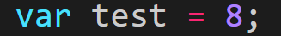
Structure of a Variable
Keyword || Name || Assignment || Value
var is a keyword to tell you code how to store your data
test is the reference of the value, how to access it
= is an assignment operator to tell test what to do
8 is the value that is being stored in the variable

Slide 7
Types of variables
For any variable created the data will be automatically chosen and updated when needed.
Beyond the data type you will need to tell the computer how to store the data
Var - basic choice, really not used for much anymore since let came into being. This is global so it is declared everywhere (Basically Deprecated)
Let - the main choice you will using for everything that is able to change. This is local so it is only used where it is declared
Const - only used if you the value should NEVER change.

Slide 8
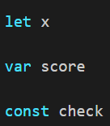
Declaring a variable
Before a work can be used as a variable to hold a value you need to declare it.
The act of declaring a word as a variable reserves the word for use later in the code and points to a specific reference

Slide 9
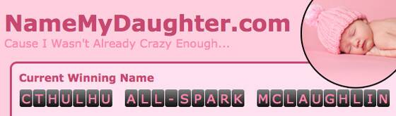
Variable Naming Conventions
When you name your variables there are a few rules that you need to follow.
Camel case for names longer than one word
var thisIsAVariableName, cheeseBurger;
No spaces can be used
var cheese Burger;
You can’t use reserved words
var this, const;
Should only start with a $, a _ , or a letter
var $this, _const;
Every name is case sensitive
var happy does not equal var HAPPY
Why we have rules

Slide 10

The ASSIGNMENT Operator =
That is not an equal sign, it is an assignment operator.
That is not an equal sign, it is an assignment operator.
That is not an equal sign, it is an assignment operator.
That is not an equal sign, it is an assignment operator.
That is not an equal sign, it is an assignment operator.
That is not an equal sign, it is an assignment operator.
That is not an equal sign, it is an assignment operator.
That is not an equal sign, it is an assignment operator.
That is not an equal sign, it is an assignment operator.
That is not an equal sign, it is an assignment operator.

Slide 11
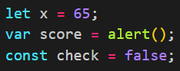
Assignment Operator
The assignment operator is used to place values into variables
x does not literally equal 65
x is the name of a variable that points to the value 65

Slide 12
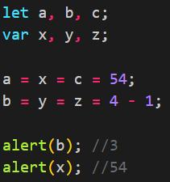
Multiple Assignments
You are able to declare several variables at once and also able to assign several variables as well.
They don’t need to be assigned together or have the same keyword declaration

Slide 13
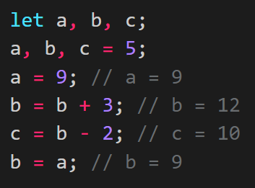
Reassignment
You can reassign variables at any times
Give them completely new values or update the values they already have

Slide 14
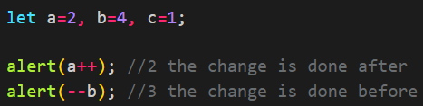
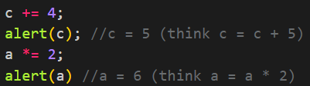
Special Operators
There are a few shortcuts that you should know
Incremental operator
Increases/decreases the value by 1
Modify and Assign shorthand
Does the operation before the assignment and then reassigns it back into the same variable

Slide 15
Data Types
How the computer defines your data

Slide 16

Data Types
Number(int) - includes any number less than 9007199254740991
BigInt - anything larger than that.
String - anything in quotes. Double (“), Single (‘), or Backtick (`)
Boolean - a check value of true or false. Different from “true”
Null - is A VALUE representing nothing or empty.
Undefined - the value is not yet assigned

Slide 17
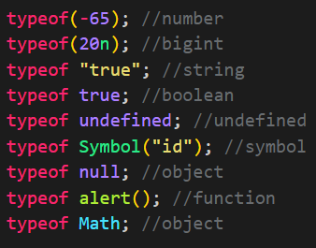
Yeah, great, but how do we check?
Whenever you want to check out the type of a variable you use the operator “typeof”
You can also use it as a function with “typeof( )”

Slide 18
Not All Variables Are Created Equal
We have 3 ways that we can compare 2 different variables
==
this checks the value and ignores the typeof
===
this also checks the typeof
Object.is(obj1, obj2)
this is the same as === expect for NaN and +0/-0

Slide 19
String Concatenation
Bringing strings and integers together since 1974...

Slide 20
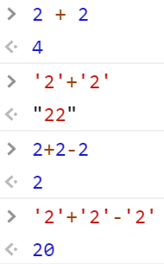
Using String Concatenation
Every language has its quirks and JS is no different.
The ‘+’ sign is a concatenation operator so when it is used with strings it combines them into a longer string
Since all other math operators aren’t they can be used with strings.
← It’s really confusing sometimes

Slide 21
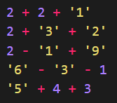
Pop Quiz
Solve these by hand

Slide 22
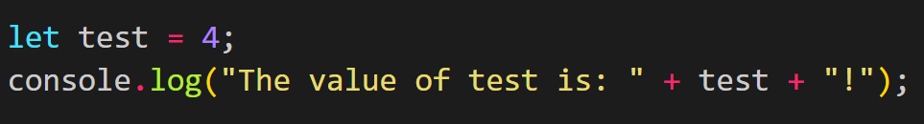
Combining Strings and Variables
You can use strings and variables in one line by using the concatenation operator.
This is very important for many console messages. So that you can describe what the value is and also have a changing message.
You can also combine as many strings and variables as you like.

Slide 23

Practice
Let’s check a couple variables that you can interpret and see what the computer thinks.
Check “17” and 17. One is a string and one is a number
And check +0 and -0. They are both numbers

Slide 24
Type Conversion
Because true is not “true”

Slide 25
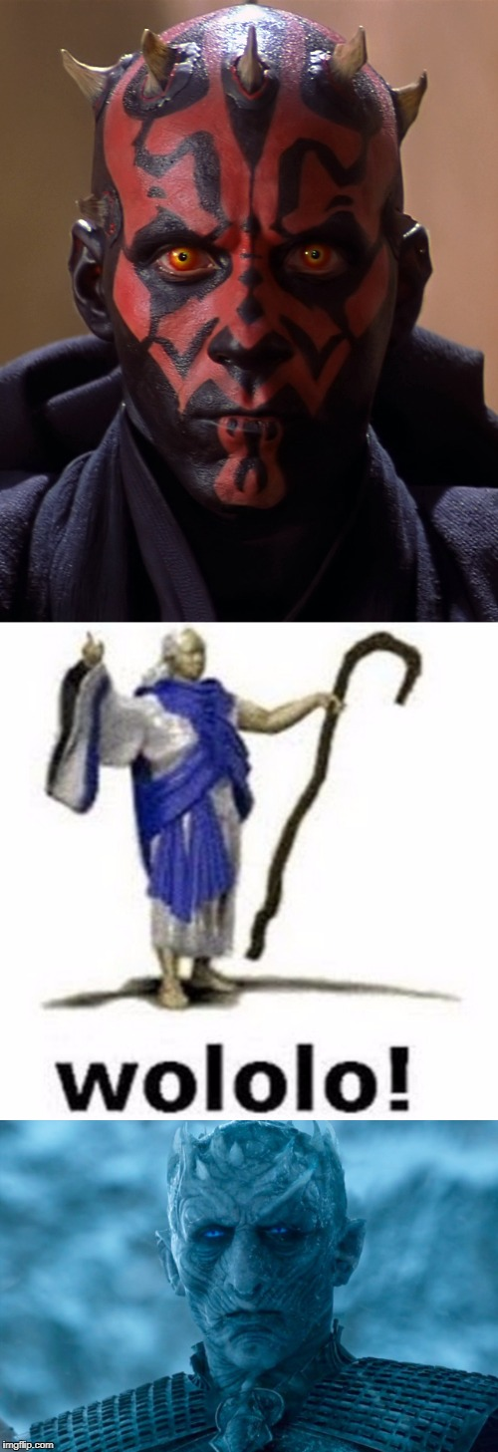
Type Conversions
You can convert any data type to any other type with a simple method
String() , Number() , Boolean()
If you are using math on strings they will automatically convert
If you concatenate your numbers with a string then the entire thing will become a string
Also outputs always convert to strings

Slide 26
String Conversions
Everything is converted to a string when you use the String() method.
String(null) = “null”
String(true) = “true”
String(84) = “84”

Slide 27
Numeric Conversion
JS will try its best to convert what you have to a number.
Number(true) = 1 , Number(false) = 0
Number(“4526”) = 4526
Number(null) = 0
Number(“”) = 0
Anything else will give you NaN (not a number)

Slide 28

Boolean Conversion
Boolean() will convert anything you have into true or false based on what you are converting
Any value that you would describe as empty will usually become false
0, “0”, “”, NaN, undefined, null, etc.
Any other value will give you true
“Hello world”, 1, “1”, 1234, etc.

Slide 29
Basic Math Operators
The fun stuff

Slide 30

Operands
Addition +
Subtraction -
Multiplication *
Division /
Exponential **
Modular %
The remainder is very useful later in programming, for now it’s just important to know what it does

Slide 31
Exponential and Remainder
There is another way to to exponential but this is how we are using this for now.
2**3 // 8 (two to the power of 3)
Roots work the same but with fractions
8**(1/3) // 2 (the third root of 8)
Remainder tells you how much is left over when you divide the two numbers
4%2 // 0 (4/2 = 2R0)
5%3 // 2 (5/3 = 1R2)

Slide 32
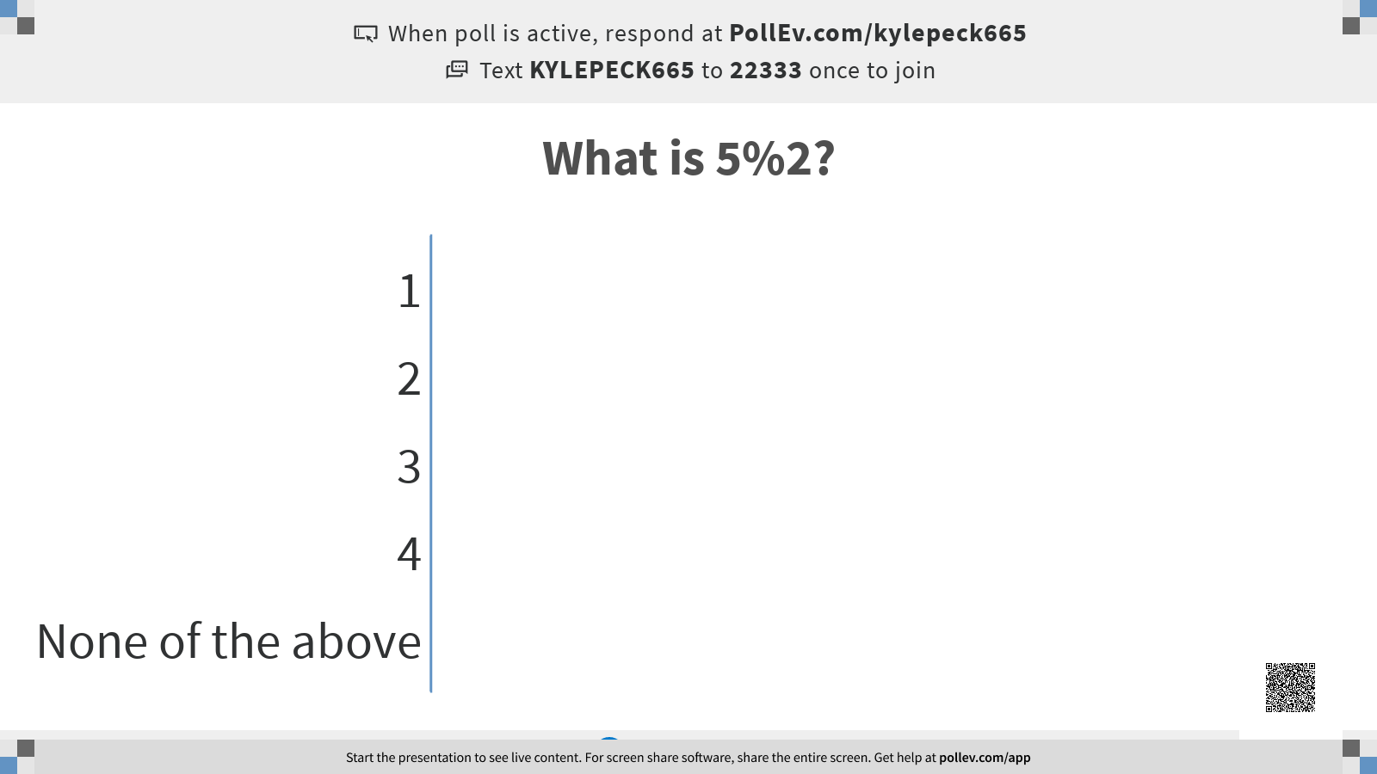

Slide 33
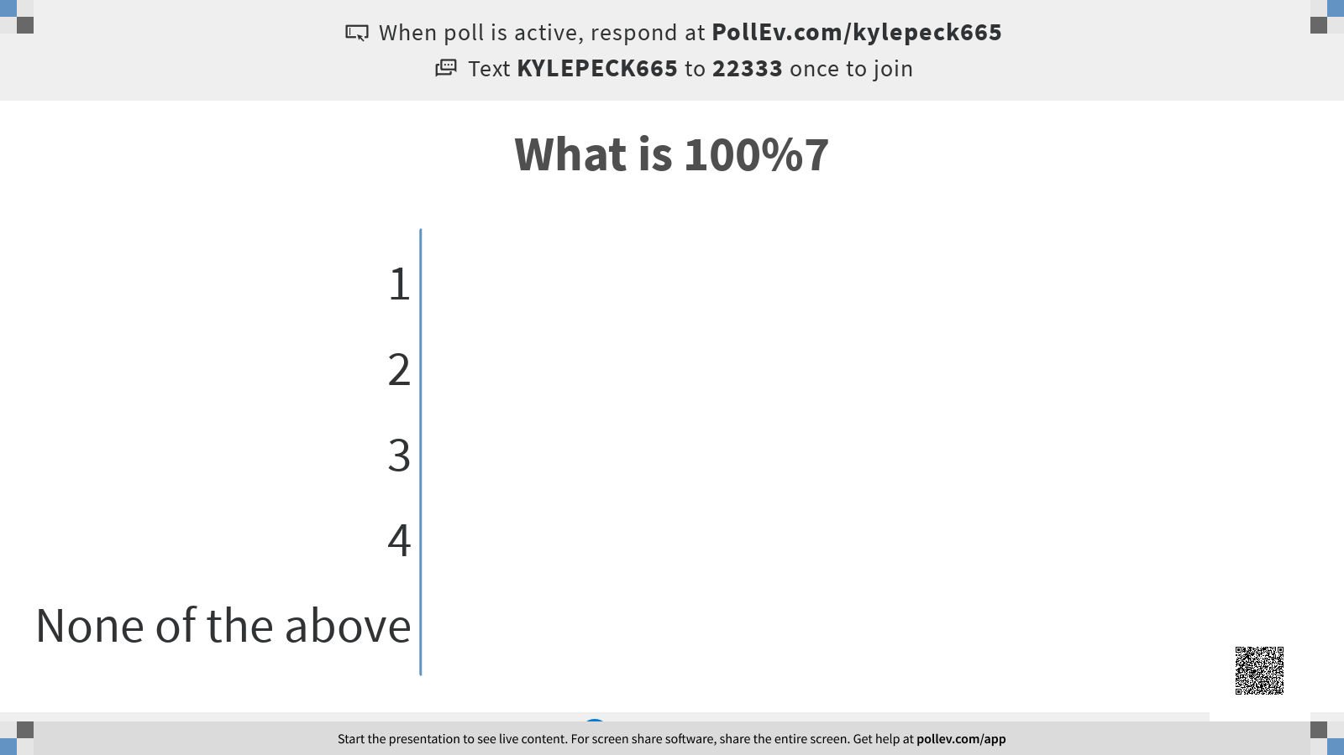

Slide 34
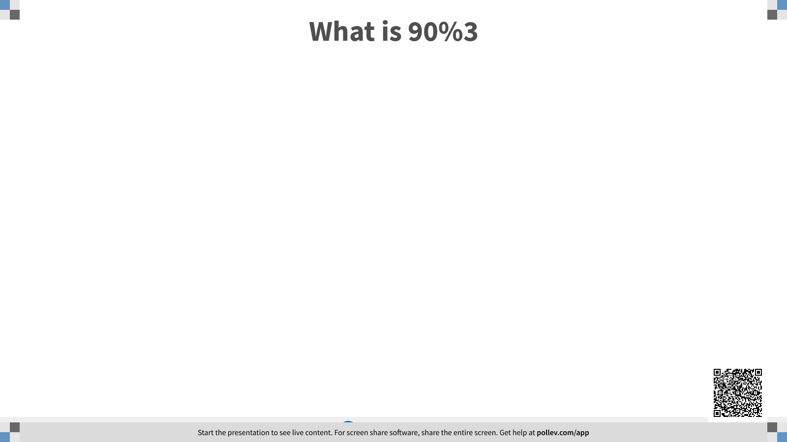

Slide 35
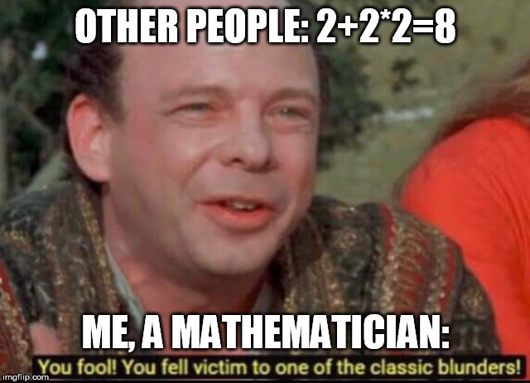
PEMDAS
P - Parenthesis
E - Exponents
M - Multiplication
D - Division
A - Addition
S - Subtraction

Slide 36
Creating a Math Solver pt. 1
You can learn from this and program some math solvers for your current math class.
Create a prompt() to ask for an input from the user.
This input should be used to find the value that is 4 times greater than the value given plus 2
The addition should happen first

Slide 37
Advanced Math Operations
This isn’t your average everyday math this is...

Slide 38
Google that Math
For the following slides you will be given 1 minutes to google the topic and post the code that you can use to achieve that purpose.
A great resource that you can use for coding is the Mozilla Developer Network
For Example:
If I said “how do you use the value of PI in your code?”
Your response should be “Math.PI” (be careful of capitals and parenthesis)

Slide 39
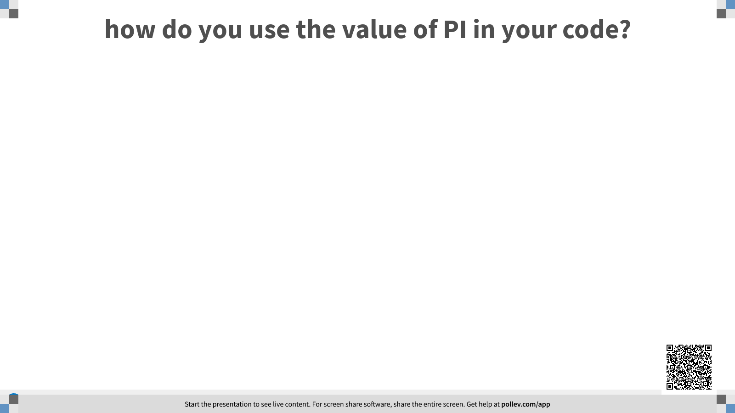

Slide 40
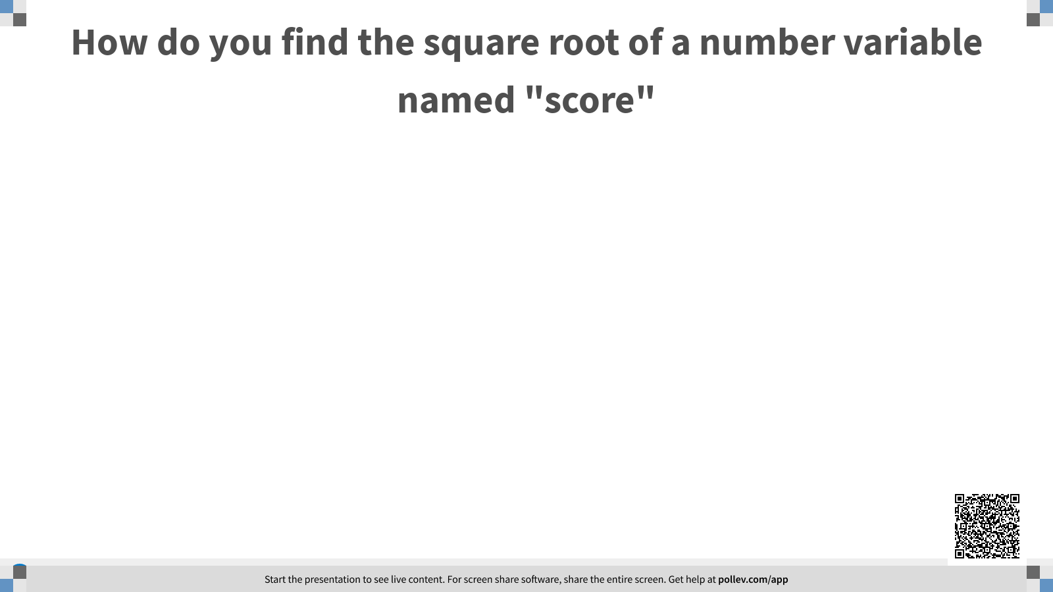

Slide 41
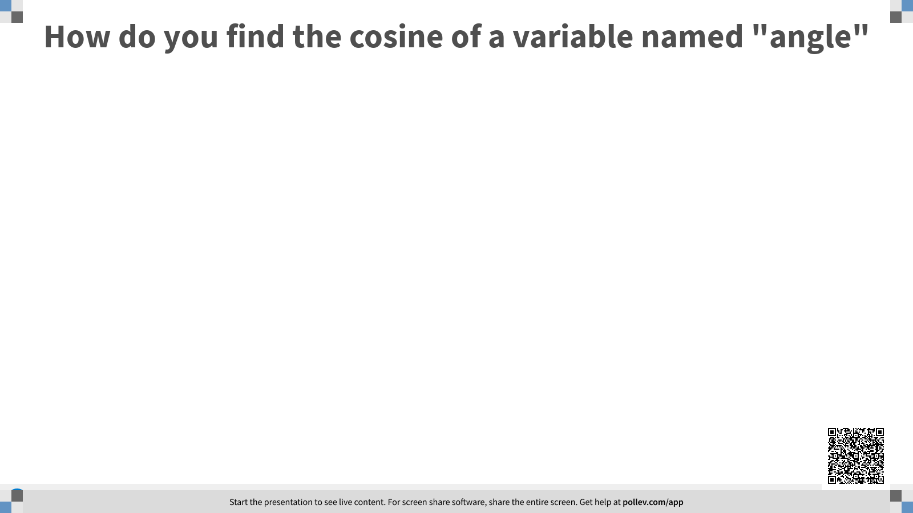

Slide 42
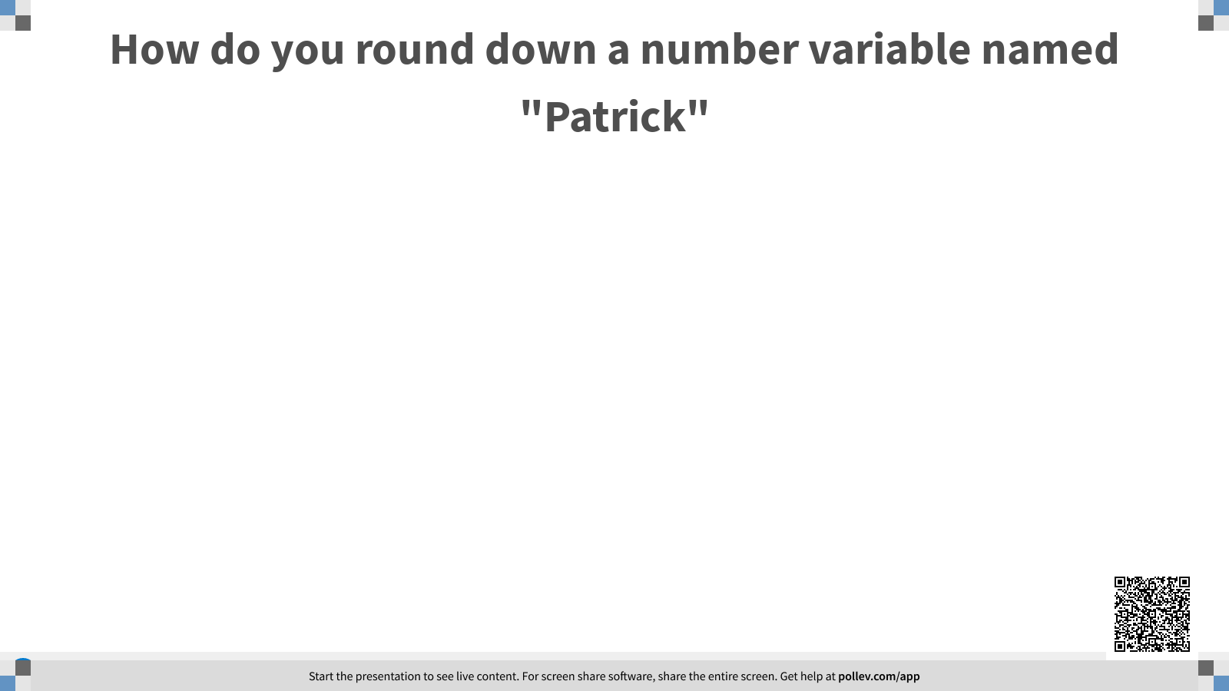

Slide 43
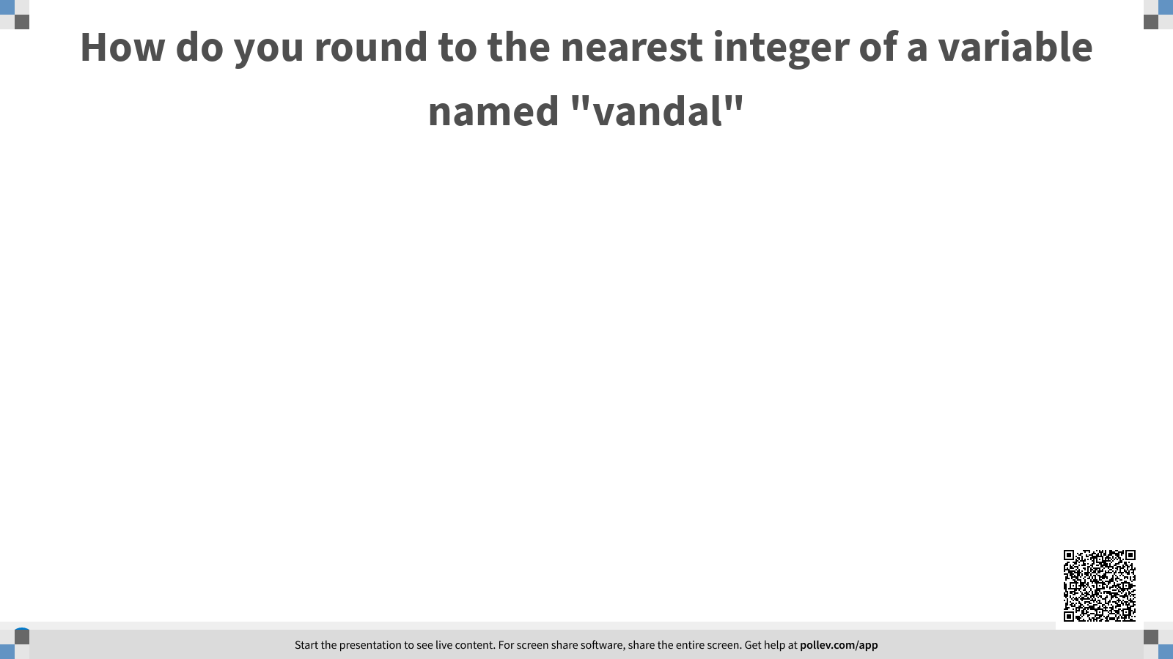

Slide 44
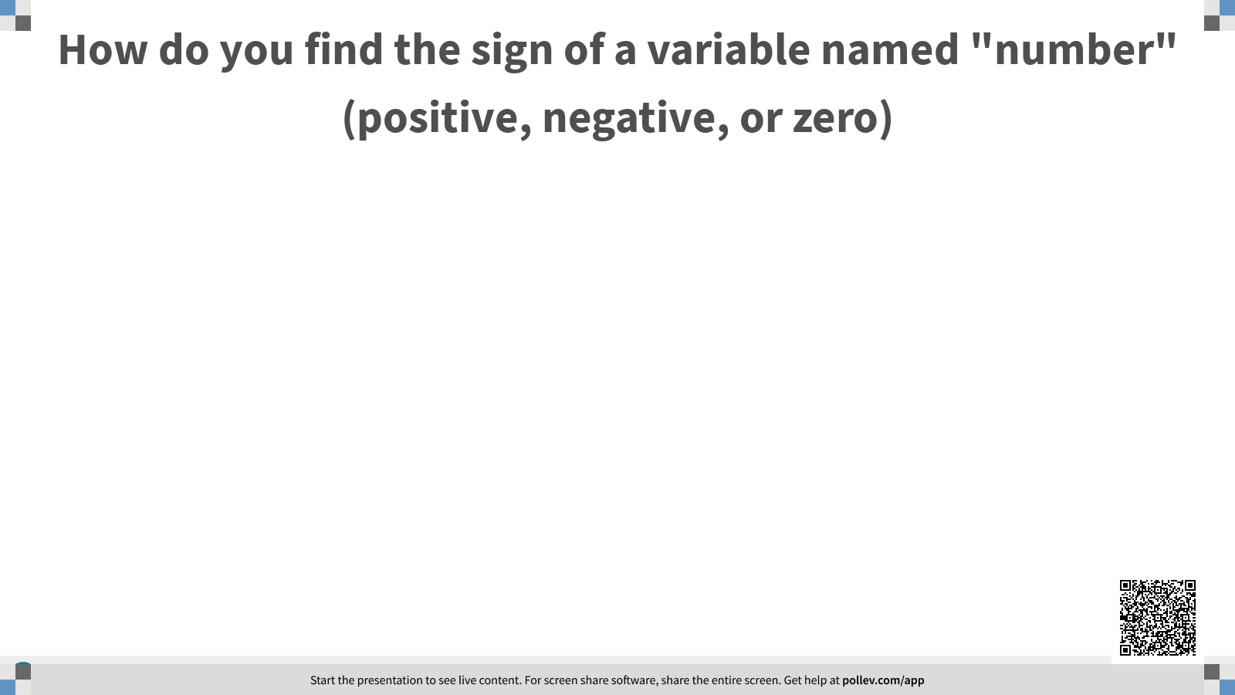

Slide 45
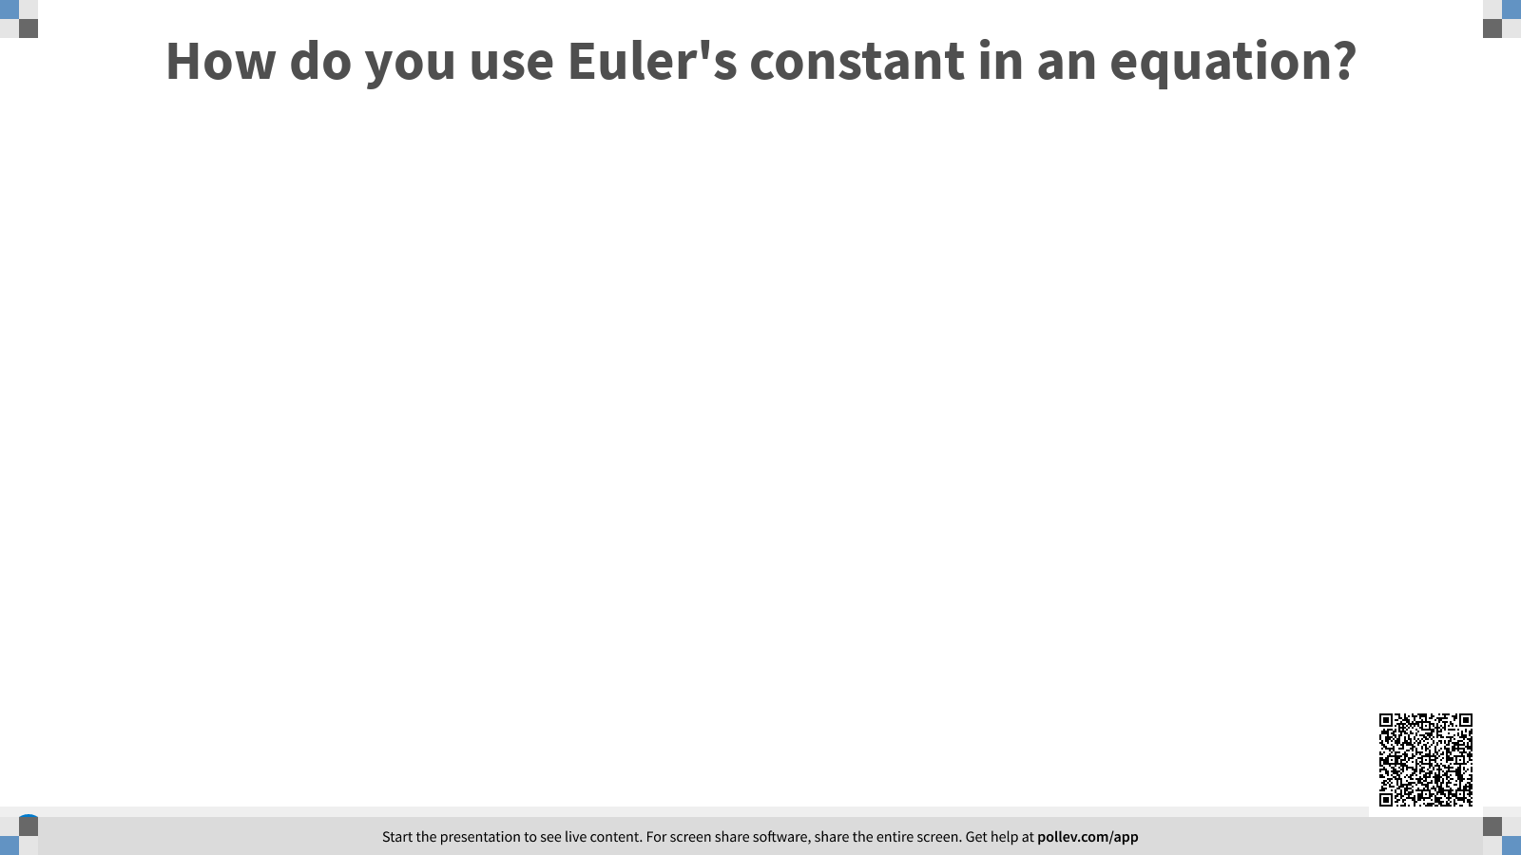

Slide 46
BELL WORK
Checkout Google Classroom and finish the form on there. Please press turn in when you are finished.

Slide 47
Math Practice 1
Create code that will solve for the distance traveled given speed in mph and time in hours.
TEST: Given Speed = 12 miles/hour and Time = 5 hours. Then Distance = 60 miles.

Slide 48
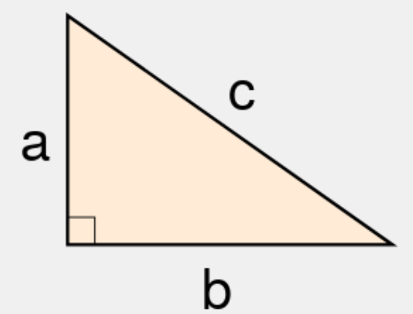
Math Problem 1
Create code that will solve for the hypotenuse of a triangle given A in cm and B in cm
LOOK UP THE EQUATION YOURSELF GOOGLE - pythagorean theorem -
TEST: if a = 6 cm and b =8 cm then c = 10 cm

Slide 49
Math Problem 2
Create code to solve for the average of 3 different integers
TEST: if the firstNumber = 90, secondNumber = 80 and thirdNumber = 85 then Average = 85.

Slide 50
Math Problem 3
Create code that will solve for the volume of a cylinder given the radius in INCHES and the height in FEET.
TEST: given the radius is 6 inches and the height is 3 feet, the volume will be 2.36 feet cubed or 4071.5 inches cubed.
(PAY ATTENTION TO UNITS)

Slide 51
Template Literals
The easier way to concatenate (It’s a JS thing)

Slide 52
The Backtick
Your IDE has 3 ways to set up “strings” in your code
Quotes (“ ”)
Apostrophes (‘ ’)
And backticks (` `)
The back backtick unique in the fact that it also converts the string into a template literal, this works just like a string but with some added tools.

Slide 53
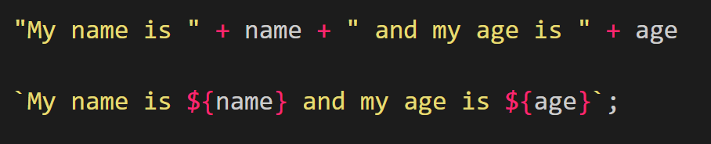
How to use it
Template literals work exactly like concatenation, when you are creating strings you are able to put variables and other data types in the string.
Instead of trying to remember all of the “ and + everytime you want to switch you can just separate them with a ${ };
EX.

Slide 54
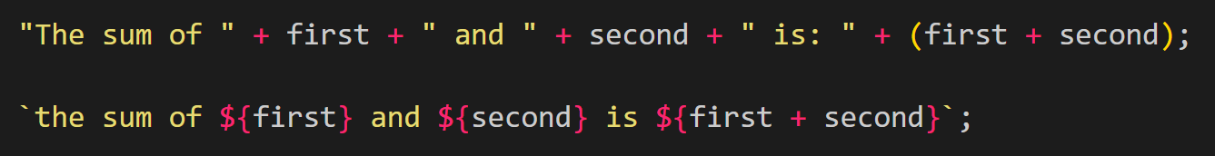
It’s ${easy}
When you normally do concatenation you need to use “+” but with string literals you can add variables in your strings more naturally using ${ }. See the examples below.

Slide 55
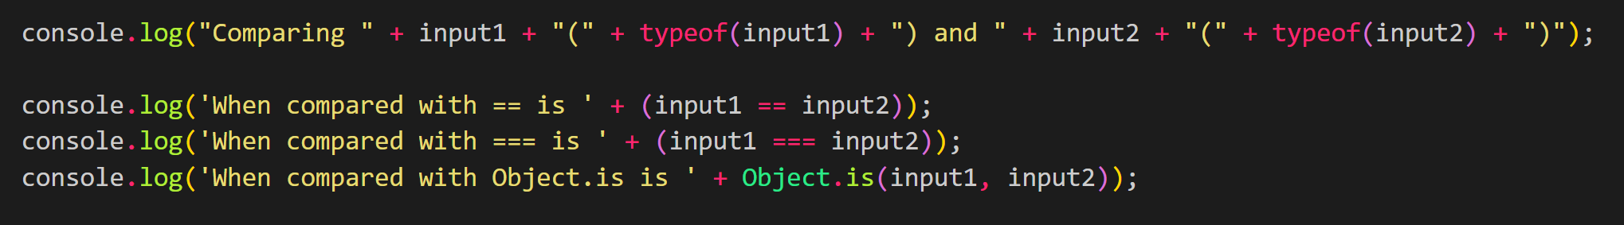
Practice Time
Lets recreate the project that you were required to do called comparing data types.
Please recreate the following using Template Literals

Slide 56
Bell Work
2.4 Bell Work
What is the difference between a normal string and a template literal?

Slide 57
Math Practice 2
Let’s work together to create a simple equation to solve for simple interest given principal in dollars, rate in percents, and time in years.
TEST: given the principal is 1000 dollars, the rate is 14 percent and the time is 12 years. The total amount should be $2,680.00
(DON’T FORGET CENTS)

Slide 58
Math Problem 4
Create an equation to solve for the density of an object given the mass and volume.
TEST: given the mass is 40 grams and the volume is 25 meters cubed then the density will be 1.6 grams per meter cubed.

Slide 59
Math Problem 5
Create code that will solve for the distance between 2 points give the 2 coordinate points
TEST: given the points are (3, 4) and (6, 8) then the distance is 5.

Slide 60
Math Problem 6
Create code that will solve for the nth term of a geometric series given n, the initial value, and the ratio
TEST: if the initial value is 4, the ratio is 2 and the n is 3. The value will be 16.

Slide 61
Math Problem 7
Create code that will solve for the nth term of an arithmetic sequence given the n, the initial value, and the difference
TEST: if the initial value is 4, the difference is 2 and the n is 3. The value will be 8.

Slide 62
Version Control
Save often and don’t overwrite

Slide 63

What is Git?
Git is a popular version control system.
You are able to save snapshots of your work giving you a history to look back on
Allows you to create branches making teamwork and collaboration much easier

Slide 64
Privacy and Safety
GitHub is open source, if you make a project that you are working on open to the public then anyone will be able to download and use it on their own.
This also means that you can borrow other people’s work as well.

Slide 65
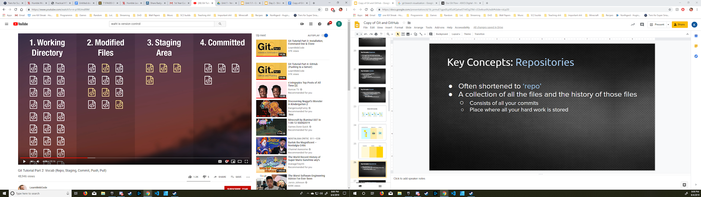
Working in Git
1. Working Directory - This is your local directory, or the folder on your computer with all of the files that are involved in your project.

Slide 66
Work Area
2. Modified Files - These are ones that have been changed in anyway, both finished and unfinished.

Slide 67
Updating
3. Staging Area - From all of the files that are changed, the staging area is for all files that you have finished updating.

Slide 68
Saving
4. Committed - When you push the finished files to online repository you create a snapshot that is saved, you can always revert back if you don’t like the change.

Slide 69
Setting Up Git Using Terminal
git config --global user.name <NAME>
After this you enter your full name. This will act like a signature on your projects.

Slide 70
Setting Up Git Using Terminal
git config --global user.email <EMAIL>
After this you enter your email. Same reason as your name above.

Slide 71
Setting Up Git Using Terminal
git config --global init.defaultBranch “main”
A long time ago the person who created branches called them “master”.
The industry is moving away from that term and starting to call it the “main” branch or the “stable” branch. This does that.

Slide 72
Setting Up Git Using Terminal
git config --global color.ui true
This allows your terminal to use colors in the output

Slide 73
Setting Up Git Using Terminal
git config --global core.editor emacs
This should already be the default on most machines but just incase something is wrong we can overwrite it. Emacs is a basic text editor that is run in the terminal for us

Slide 74

What is GitHub?
GitHub is an online cloud for hosting repositories
This is different from Git but they work together to allow developers from around the world to collaborate and share

Slide 75
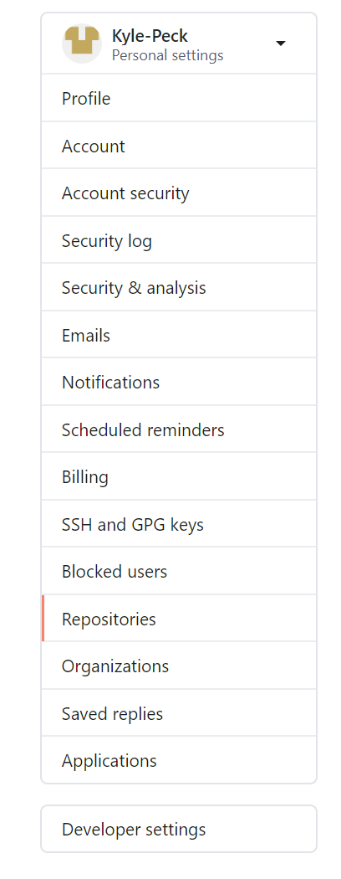
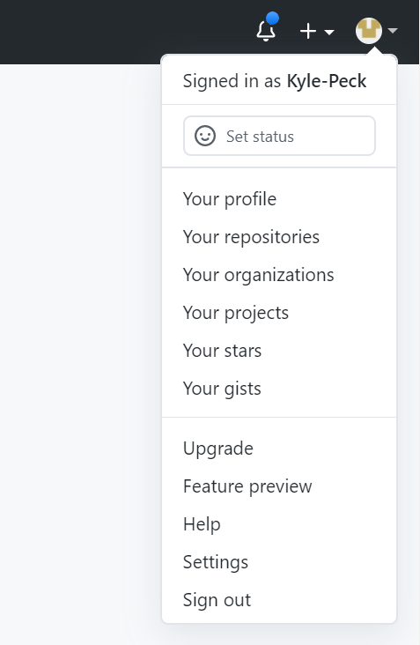
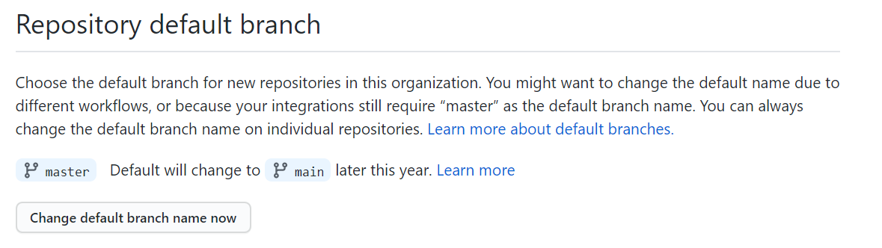
Changing Your Default Branch
Like I said before, we need to change the default name from “master” to “main” Please go to your settings and follow the arrows.
2.
1.
3.

Slide 76
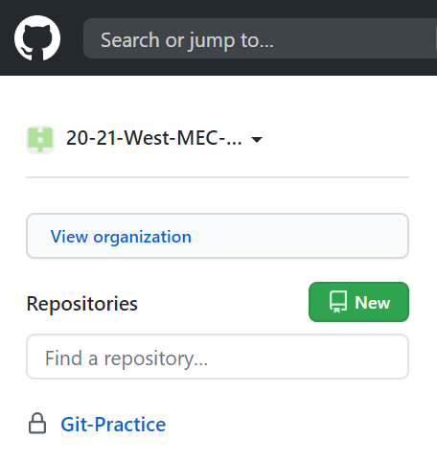
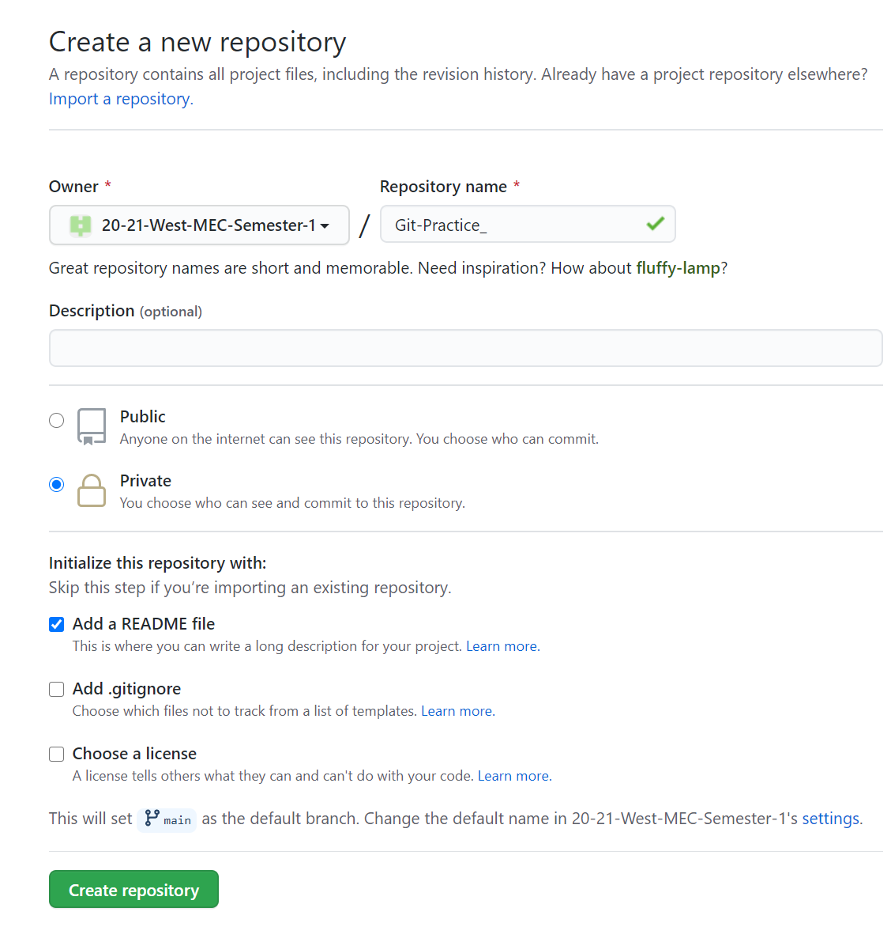
Using GitHub
We are going to create a new repo on github please log in and look for the new button in the top right.
Please name the repository “Git Practice”.
Make the Repo Private.
Initialize the Repo with a README file.

Slide 77
Setting up your local repo
Now that we have an online repository let’s move it to a local repo
Please navigate to where you want your local repo created and then use the following code
git clone URL
This will create a directory on your computer that you can modify in conjunction with GitHub

Slide 78
Updating Your Repo
We are going to use terminal to add all 3 standard files to the repo.
PC:
cd. > FILENAME
MacOS:
echo > FILENAME

Slide 79
Updating your Repo
Please use those codes to add :
index.html
style.css
math.js

Slide 80
Updating your Online Repo
Saving your work to the cloud

Slide 81
IMPORTANT TERMINAL COMMANDS
git status
We can see how our files are doing by checking the status of them.
Since we just added those 3 files we can see that they are now considered modified files.

Slide 82
IMPORTANT TERMINAL COMMANDS
git add -A
Now that we have added files to our local repo we need to move them to the staging area so that we can save them.
This only moves modified files, saving space and time.

Slide 83
IMPORTANT TERMINAL COMMANDS
git commit -m <COMMENT>
This will take those files that you just added and commit, or save, them as a snapshot in your repo.
Make sure the comment on the end of the commit is meaningful for what you completed since the last commit.

Slide 84
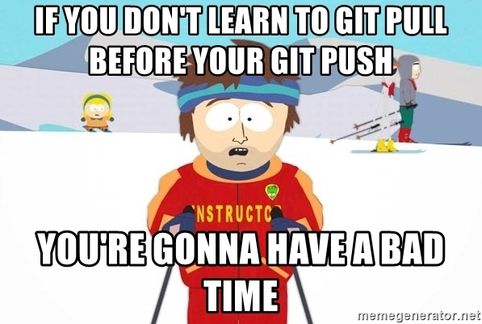
CONFLICTS
When you pull or push there is a chance of getting a conflict, A file that has been modified by you and someone else since the last save
To help prevent this make sure you always pull before you push, this will allow you to fix conflicts locally and then push it when you are done.

Slide 85
IMPORTANT TERMINAL COMMANDS
git pull
Pull will update your local repo to match the online repo.
If another team member has committed work for the project and you need to get that work onto your local repo to work, you use pull.

Slide 86
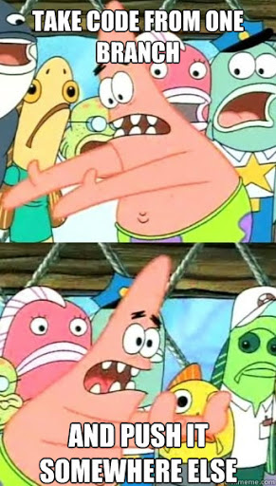
IMPORTANT TERMINAL COMMANDS
git push
When you commit it is only saved on the local repo, we use push to then save update your online repo (GitHub).
Another benefit is that you can then share this work with anyone else on that repo.

Slide 87
Bellwork
Please go onto google classroom and see the west-mec return to in-person packet.
While we wait please read through it as much as you need and then ask any questions that you have about returning in person. I want to answer all of them and before class starts is the best time. (you can ask on mic or message or private message if you want.)
I also added cheat sheets to the class if you want to download those

Slide 88
Branches
This will let you work on several things at once without conflicts

Slide 89
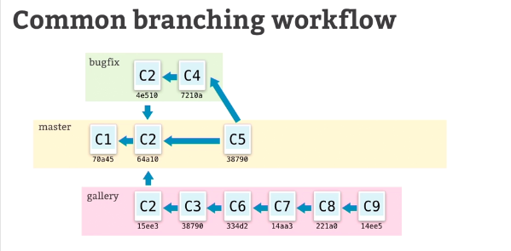
Branching
In order to avoid conflicts in coding you can use branches
Branches create a seperate snapshot, kind of like your own work space, so that you can save all you want without changing the main branch.

Slide 90
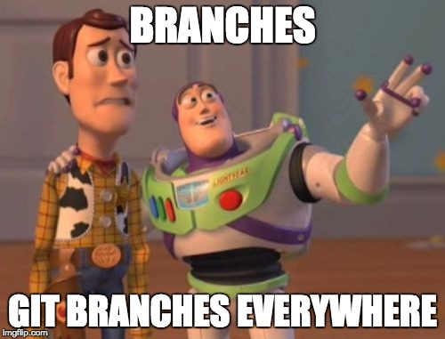
Branching
git branch [BRANCH]
This will create a new branch that you can use to do work away from your main branch.

Slide 91
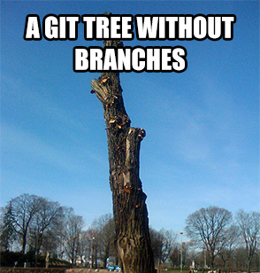
Branching
git checkout [BRANCH]
This will switch you to a new branch. Now when you commit it will be saved under this new branch and won’t overwrite the main branch.

Slide 92
Some Extra Commands
git checkout -b [BRANCH]
Will create a new branch AND switch to it
git diff
Will show you what has been added since the last commit
git [command] --help
Will open a document that will help you with that command

Slide 93

Branching
When creating branches make sure that everyone knows the layout and where their work should be done.
ONE PERSON IS IN CHARGE BOTH IN INDUSTRY AND IN CLASS!

Slide 94
There has to be a better way...
Merging is EXTREMELY annoying and hard to do in the console, so we don’t… The easy way is usually the better way.
If only there was a program out there that would help us to deal with conflicts...

Slide 95

Well, now there is! GitKraken
On your machines you can install a 3rd party software called gitkraken
GitKraken is a tool that allows us to visualize the Git process
This is the main tool used in industry to help with large scale projects and you helps immensely with merging conflicts.

Slide 96
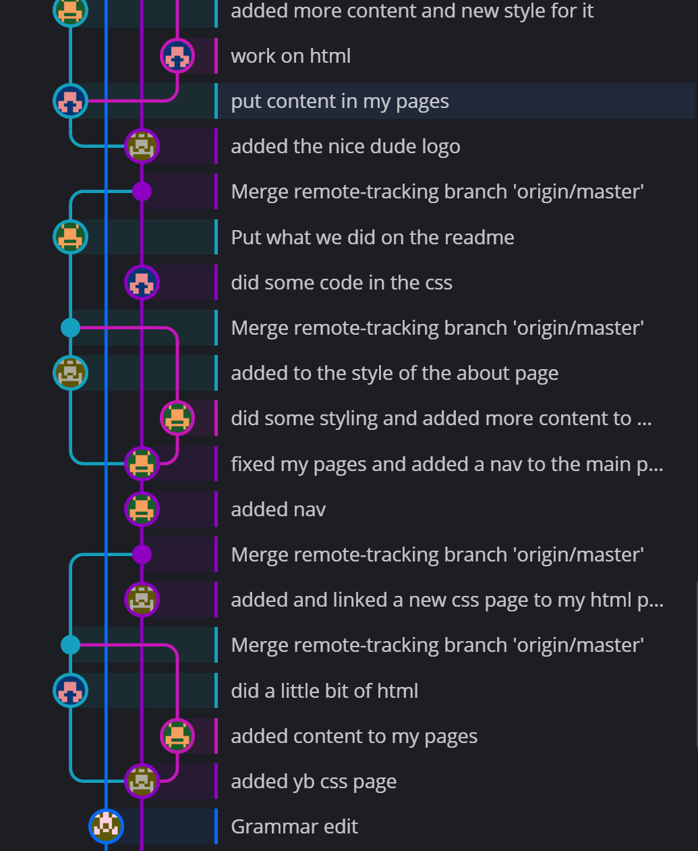
Visualizing branches
Every commit is saved in order no matter who submitted it
Older branches are color coded to help prioritizing.
The comments are always visible on the right side of the screen
There are lines drawn from 1 snapshot to another when branched or merged

Slide 97
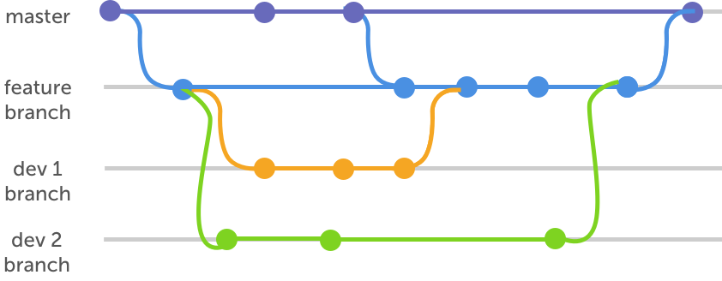
Naming Branches
The branches that you create should give meaning to what is going to happen in them.
When you work in small groups you can name the branches by your names or by what you are working on.
A few branches that you will see a lot are “features”, “main”, “bugs/patching”, ”release” and “dev”

Slide 98
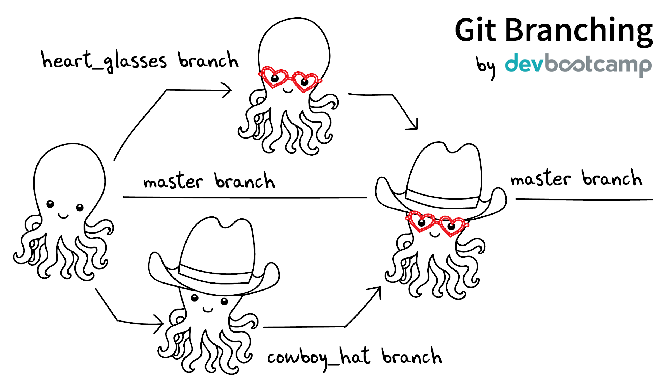
Merging
When you finish up with the work on your branch, such as fixing a bug or updating your UI then you can merge your branch back into the main branch.
Merging is the act of combining the information added in one branch to the information present in another branch.

Slide 99
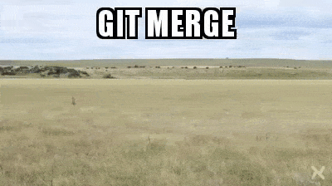
Git Merge
git merge [branch]
git merge [branch] will merge the current branch that you are on with the one that you name in the command
Merging two branches in git combines the information from the two branches, when you do this with a larger project you will definitely need to deal with conflicts.

Slide 100
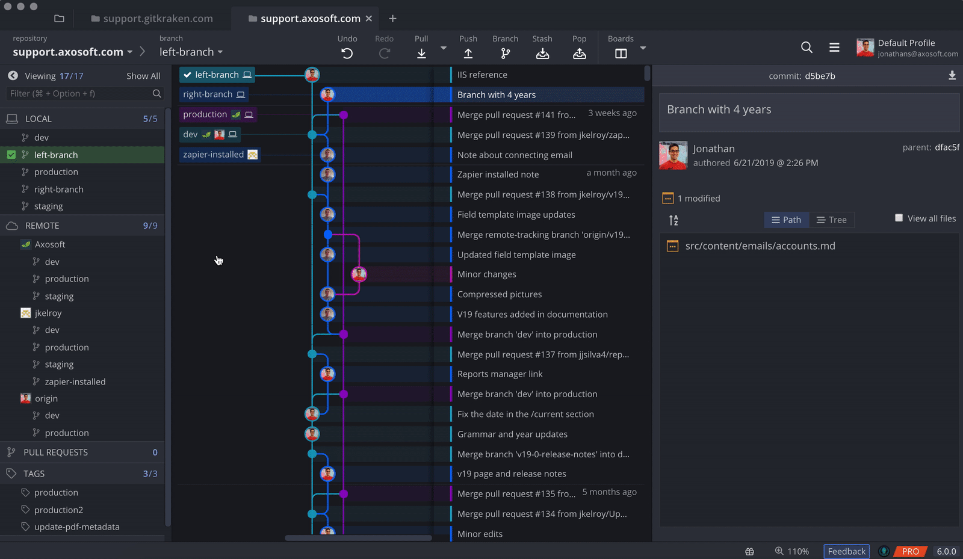
Git Merge

Slide 101
Node.js
Compiling code in your IDE

Slide 102
Node Introductions
Node is how we run, or compile, our code without using a browser.
This tool is used to test code, run programs, and debug in the industry
If you want to program in js you will NEED to learn Node.
And we will in a later unit together

Slide 103
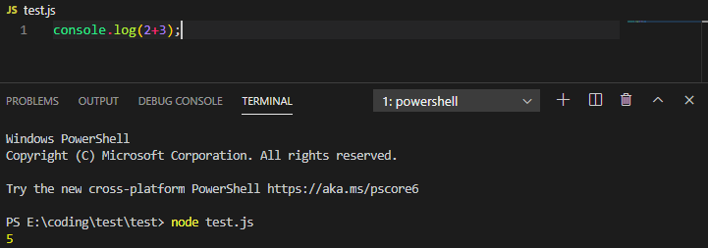
What you need to know for now
In order to run your code in your IDE you just need to type node [JS FILE] and the terminal will act as a console like the one in the browser

Slide 104
Binary, bytes, and hexadecimals
Computer language

Slide 105
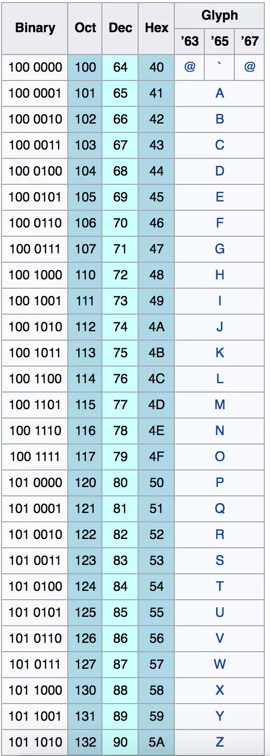
Bits
A bit is a single entry of data, a 1 or a 0 that the computer can read and understand as on or off.
These bits are combined together to tell the computer everything it needs to know.
For example 0100 0001 is the letter A
These conversions are stored in a format called ASCII

Slide 106
Bytes
Computer storage works 8 bits at a time
With that many bits in a row we can create 256 unique combinations
To make it easier for people using computers we call these sections bytes
8 bits are 1 byte
Bits are read left to right and have a space in the middle (i.e. 0100 0001)

Slide 107
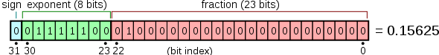
Bytes
Usually the operating system tells your computer how to break up your bytes, you most likely have a x64 bit OS (if you are downloading files you have seen this before)
The 64 bit means that data is usually stored in a 8 byte format for instance :
a = 00000000 00000000 00000000 00000010

Slide 108
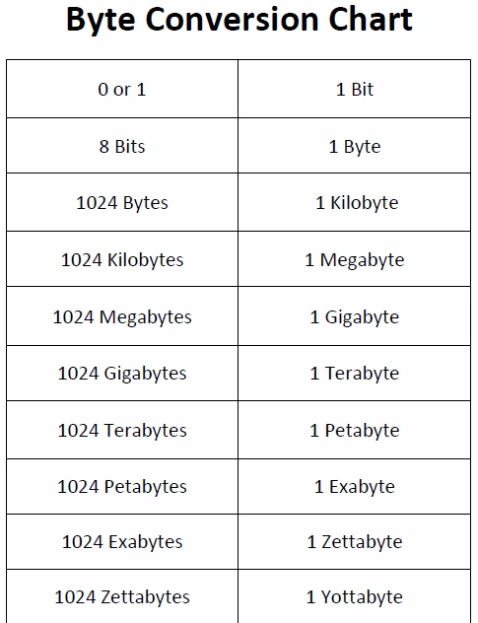
Byte Conversions
Saying we have 1,000,000 bytes of storage is cumbersome , so we convert every 1000 into a shorter way of saying it.
For example 1,024 bytes is a kilobyte and 1,048,576 bytes is a megabyte
And now we can use code to help us with conversions

Slide 109
Bytes
For developers we always deal in groups of 8 bits, or 1 byte, so we say:
1 = 0000 0001
1011 = 0000 1011
10001 = 0001 0001

Slide 110
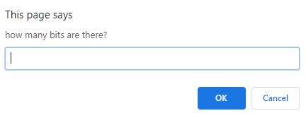
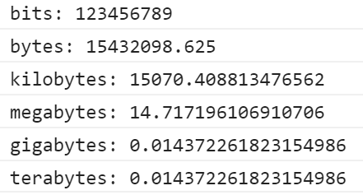
Practice - Bit Conversions
Create a prompt that will ask how many bytes.
It will then print out every conversion up to a terabyte

Slide 111
Bytes to Decimal to Hexadecimal
Every counting system is done with a base in mind, how many times you count before moving to the next digit.
We count in a base 10 system. 0-9 and then we move to the tens place which has its own 0-9
Bytes are in binary which is a base 2 system. 0-1 and then it moves to the next digit.
Hexadecimal is in base 16. 0-9, A, B, C, D, E, F and then it changes to the next digit

Slide 112
Conversions - the confusing part
Decimal
Binary
Hexadecimal
0
1
2
3
10
15
16
0000
0001
0010
0011
0110
1111
0001 0000
0
1
2
3
A
F
10

Slide 113
How to Convert binary Decimal and Hexadecimal
Division.
We will do this on the board. It’s easier and I’m Lazy

Slide 114
Project Time
Please create groups of 3-4 with the people in your row. These will be your groups for a while so please support each other and come to me with concerns.
Assign roles
Team Manager - controls the repo and is incharge of merging. Assigns jobs and keep team on task. Needs to be strong in leadership and decent at everything else.
Web Designer - designs the page and makes it look nice. Needs to be artistic and creative as well as strong in CSS
Content Designer - Will make sure there are no spelling errors and that everything is ready to be turned in. Needs to be strong in organization, reading, and writing.
Web Developer - The go to with debugging any coding. Needs to be strong in JS.

